Slide 2

Toegankelijkheid

Slide 3
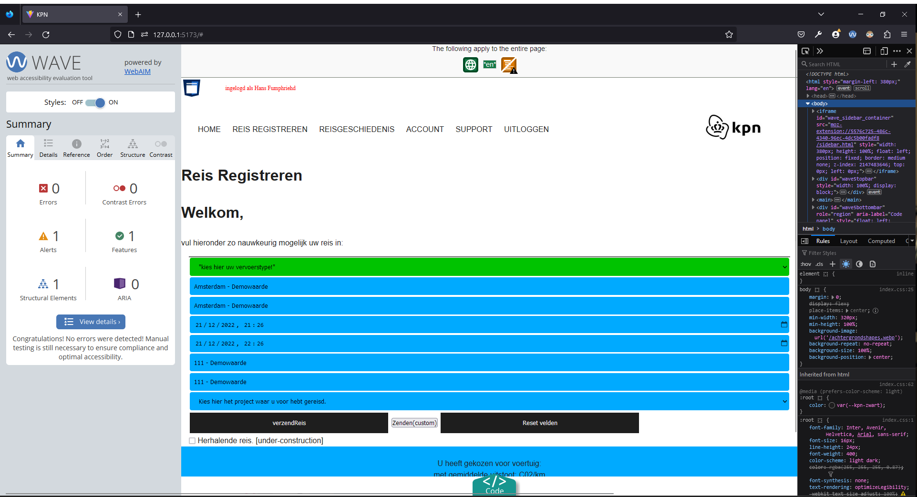
Light mode accessibility-test

Slide 4
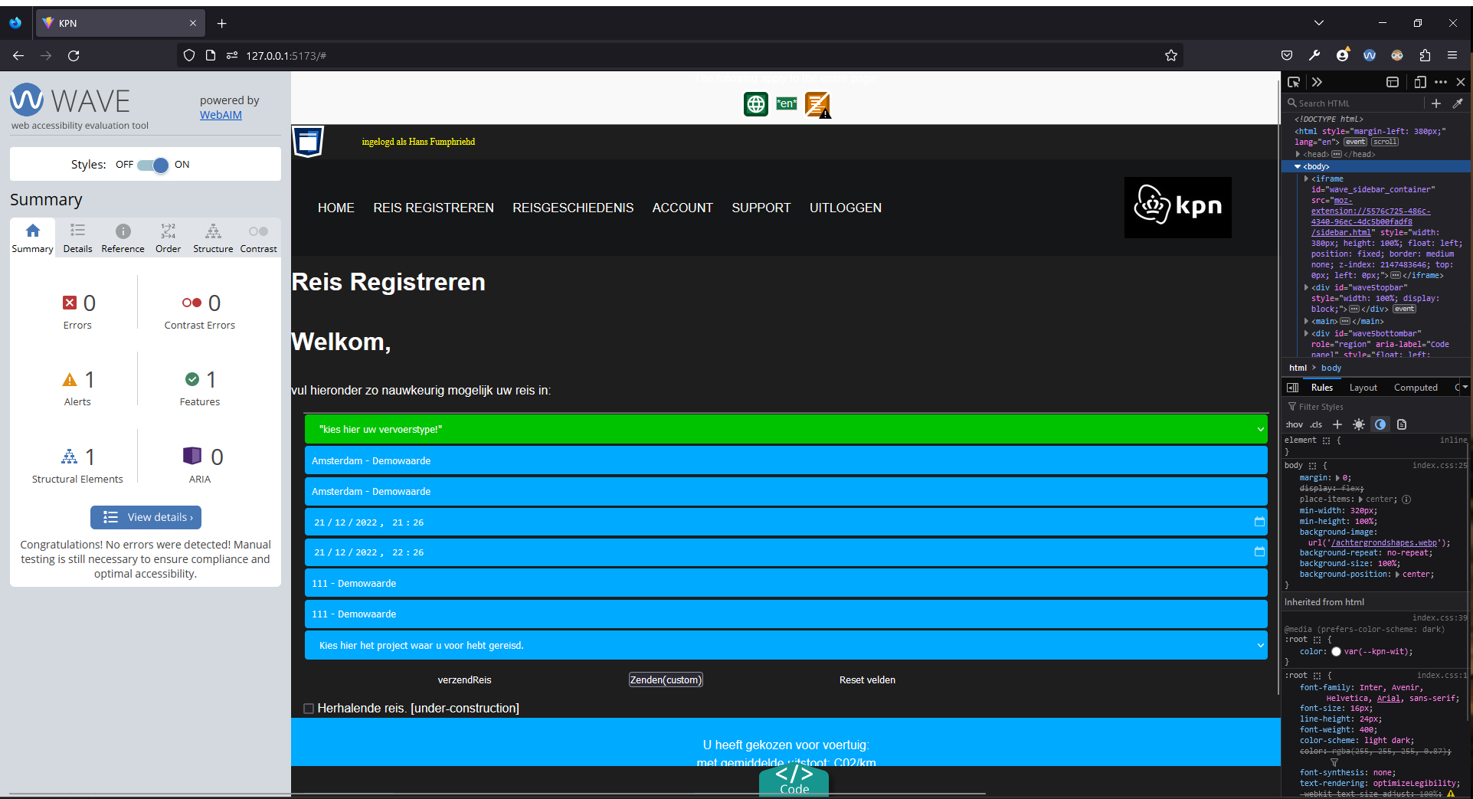
Light mode accessibility

Slide 5
Project Management

Slide 6
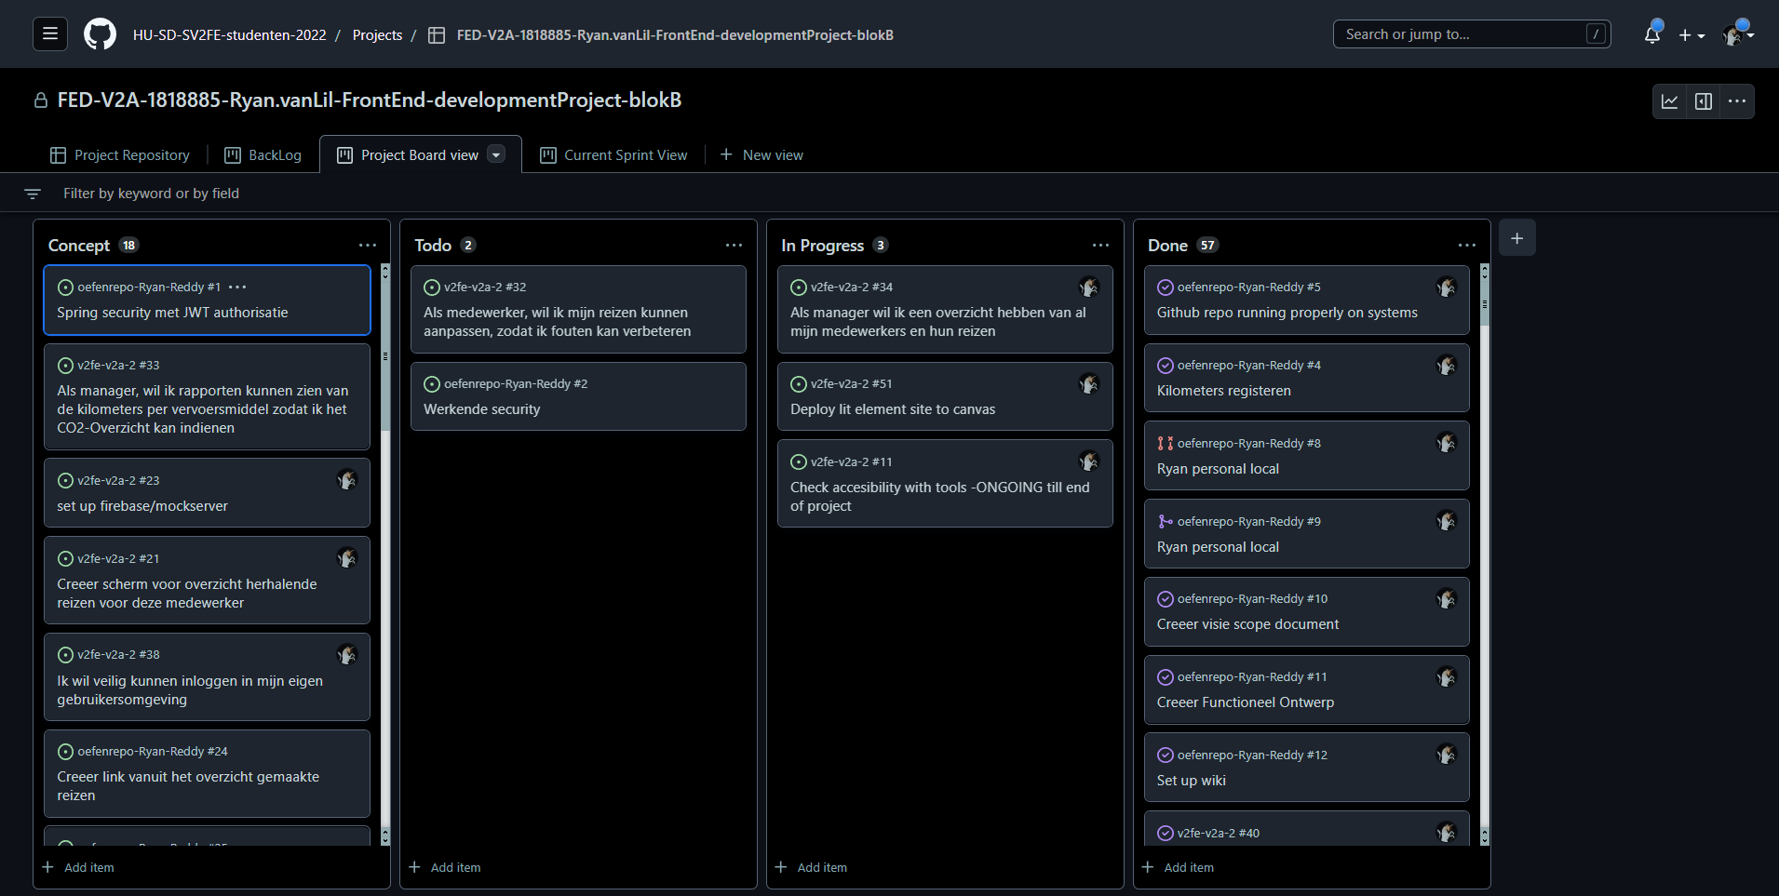
Project Board View

Slide 7
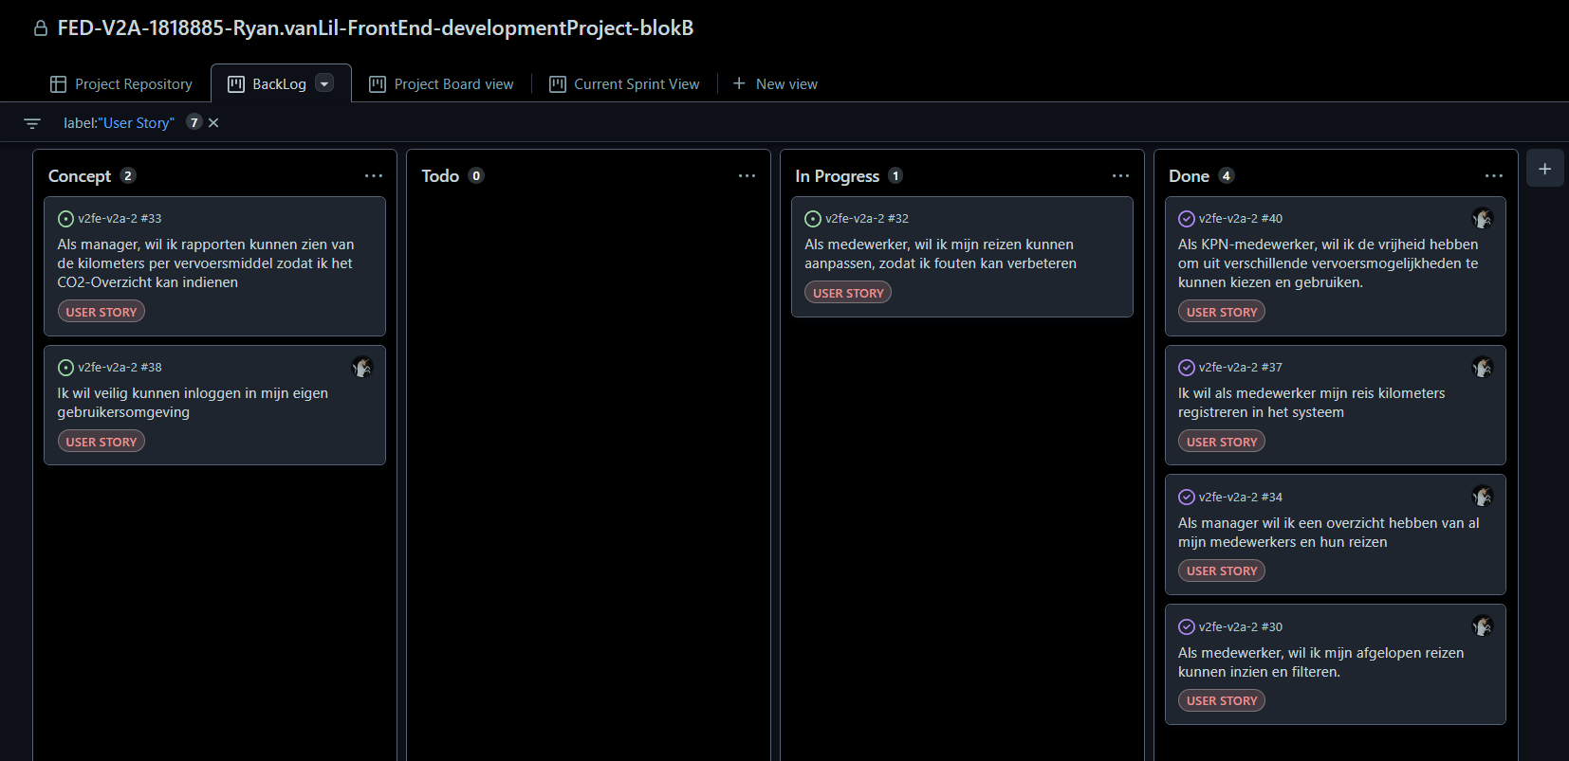
Backlog

Slide 8
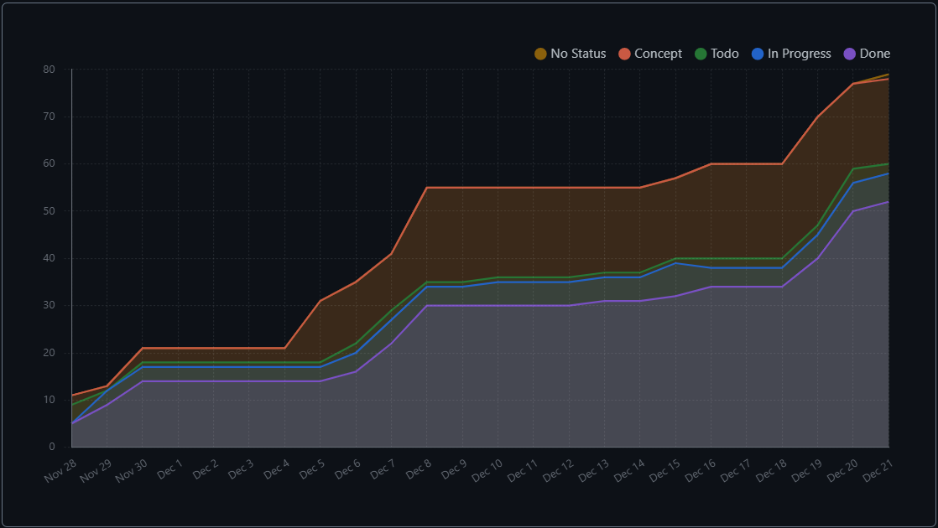
Burndown chart

Slide 9
